Slide 1
X-Copter
Development a platform to test several sensors or
processes for a autonomic aircraft

Slide 2
Simple Flight Controller
Replacing the commercial flight controller
Requirements:
For Quadcopter
Manual height control
Automatic position holding
Automatic balance
Automatic spinning control
Using accelerometer and gyro meter

Slide 3
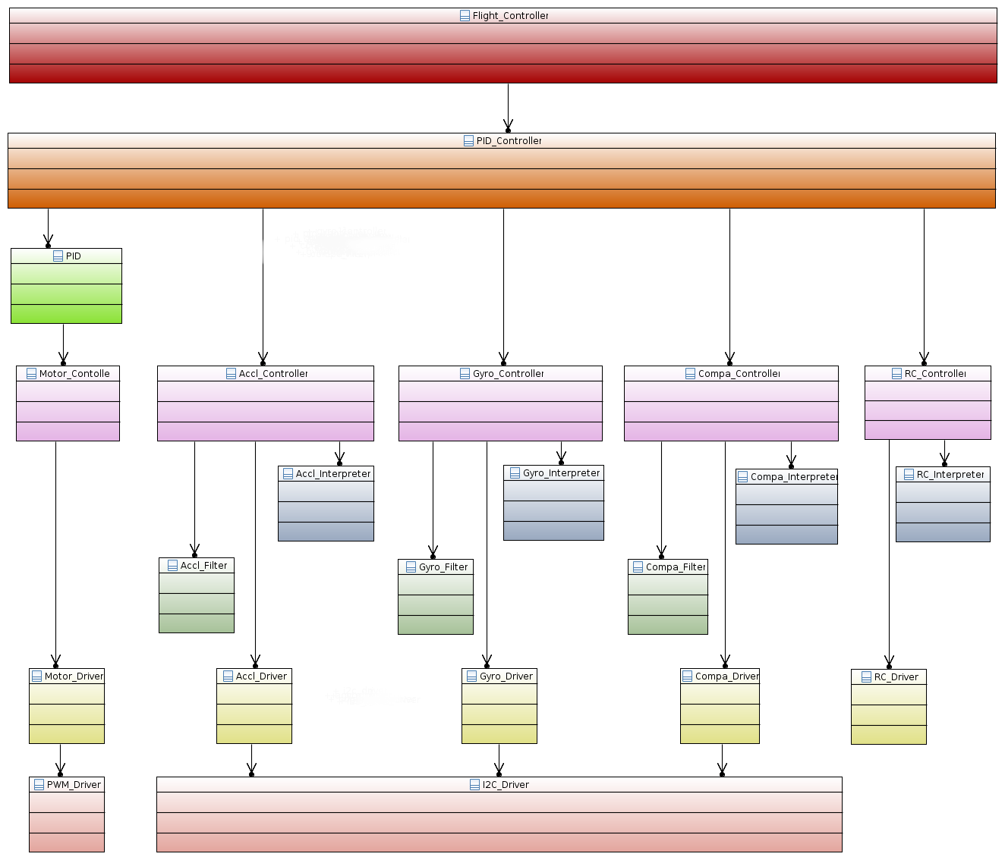

Slide 4
Simple Flight Controller
Development Status Demonstration

